Slide 1

In the name of Allah (God), the most beneficent
and most merciful
1
Notes:
1

Slide 2
Proposal Defense
DATABOT
Group Members
Muhammad Sanan (Cu-481-2018)
Mustafa Haider (Cu-470-2018)
Hamza Ayaz (Cu-524-2018)
Project Supervisor
Ma’am Zainab Jamil

Slide 3
CONTENTS
Introduction
Literature Review
Block Diagram
Tools to be Use
Time Line
References
3
Notes:
3

Slide 4

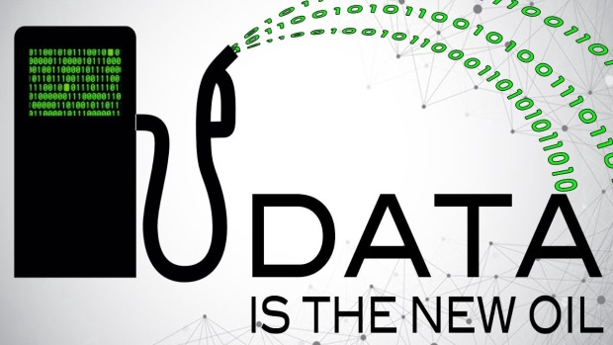

INTRODUCTION
Just look the most valuable companies in the world. In 2006 these were the oil and energy companies. In 2012 the list included Google, Amazon and Facebook.
The world’s most valuable resource is no longer oil, but data.
To design and develop such application that extract products data from different e-commerce stores and show all the products in one place so the user can buy products within their range.
4
Notes:
4

Slide 5
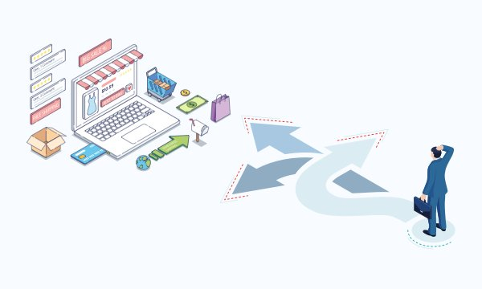
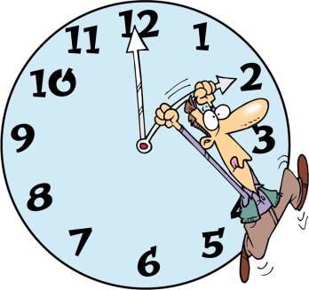
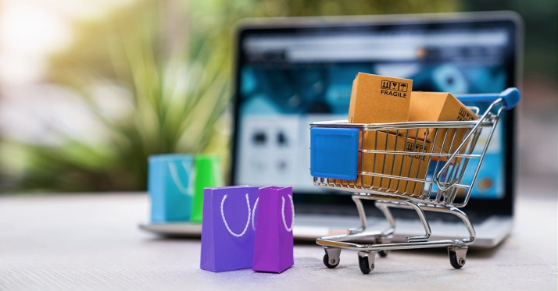
PROBLEM STATEMENTS
In Pakistan there are to many e-commerce stores and there are also millions of products available in different market place. For a user it is difficult to check all the sites and compare their products.
it is time consuming process for the user to find the products within their range from a different stores.
There is no proper application that gathers all the Local brands products from different stores.

Slide 6



SOLUTION STATEMENTS
As above problems that we discuss. The solution is that we are developing such an application that gathers all the Local brands products from different stores.
As all the local brands are in one place so the buying process for the user is easy.
Our proposed application will be available for Android, and web users. From where they will check all products of brands and buy within their range.
.

Slide 7



LITERATURE REVIEW
“ FARFETCH” is a British-Portuguese online luxury fashion retail platform that sells products from over 700 boutiques and brands.
“ZASIMO” Pakistan’s largest online destination for the latest and best western high street and international fashion, footwear and accessory brands.
“ LYST ” Shop and discover the world's most stylish brands, curated for you. With more than 1000 brands and stores in one place.

Slide 8
LITERATURE REVIEW
Applications | Targeted Brands | Platforms
FARFETCH [1] | Alexander McQueen, Balenciaga, Bottega Veneta, Gucci, Givenchy, Prada, Saint Laurent, Versace | Web Application
ZASIMO [2] | New Look, Burton, Jack&Jones, Quizman, Bravl Soul, Only, Blend | Web Application
LYST [3] | Nike, Gucci, Moncler, Barbour, Diesel, The north face, Kenzo, Balmain | Web Application
DATABOT | J., Almirah, Heels, Leisure Club, Metro, Ndure, Shoeplant, urbansole, Servis, Edenrobe, Bareeze, Breakout, Sanasafinaz, Outfitters,Alkaram etc…. | Web, Android

Slide 9
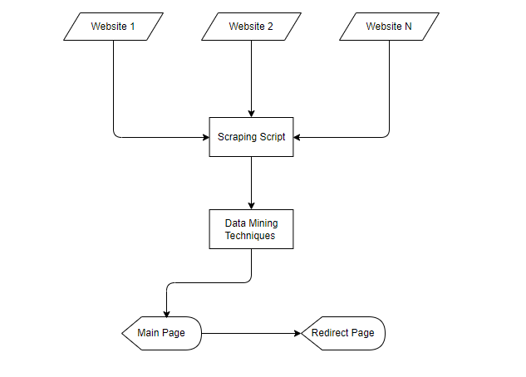
BLOCK DIAGRAM
9
Notes:
9

Slide 10





TOOLS
JavaScript
React
NodeJS
Netlify
Heroku
Visual Studio Code

Slide 11
TIME LINE
Activity | Duration
Proposal defense
Requirement Gathering
Design
Implementation
Testing
Report Writing
 | Jan | Feb | Mar | Apr | May | Jun
11
Notes:
11

Slide 12
REFERENCES
[1] https://www.farfetch.com/al/shopping/men/items.aspx
[2] https://zasimo.pk/
[3] https://www.lyst.com/
12
Notes:
12

Slide 13
Thank You
13

